Slide 1


Department of BES-1
DATA STRUCTURES Using python
24sc1204
Topic:
Merge sort analysis &
implementation
Session - 7

Slide 2



AIM OF THE SESSION
To familiarize students with the basic concept of Merge Sort its concepts its time complexity
INSTRUCTIONAL OBJECTIVES
This Session is designed to:
Demonstrate: Merge Sort
Describe: Merge Sort Algorithm
List out the: Application of Merge Sort
Describe the: time complexity of merge sort
LEARNING OUTCOMES
At the end of this session, you should be able to:
Define: Merge Sort Algorithm
Describe: Time complexity of merge sort
Summarize: Merge Sort Algorithm

Slide 3
Session Outcomes
What is a Sorting Algorithm?
What is Merge Sort?
Merge Sort Approach?
Time Complexity of Merge Sort?

Slide 4
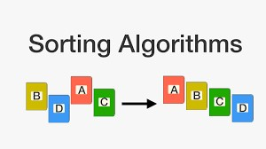
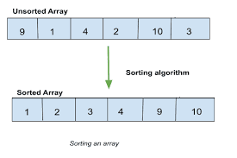
INTRODUCTION
Merge Sort is a divide-and-conquer algorithm that divides the array into two halves, sorts them recursively, and then merges the two sorted halves into a single sorted array.
In ascending order, we will merge the two halves such that smaller elements come before larger elements.
Steps for Merge Sort (Ascending Order):
Divide the array into two halves.
Recursively sort both halves.
Merge the sorted halves while ensuring the array remains sorted in ascending order.

Slide 5
Merge Sort Approach
To sort an array A[n1,n2.. . ….nr]:
Divide:
  Divide the n-element sequence to be sorted into two subsequences of n/2 elements each
Conquer:
  Sort the subsequences recursively using merge sort
  When the size of the sequences is 1 there is nothing more to do
Combine or Merge:
  Merge the two sorted subsequences
Merge sort is defined as a sorting algorithm that works by dividing an array into smaller subarrays, sorting each subarray, and then merging the sorted subarrays back together to form the final sorted array.

Slide 6
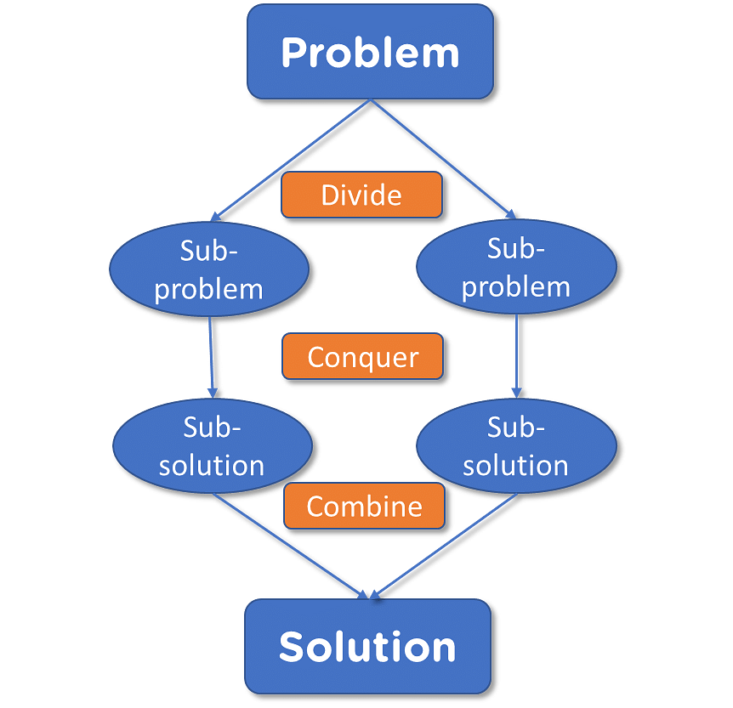
Merge sort:

Slide 7
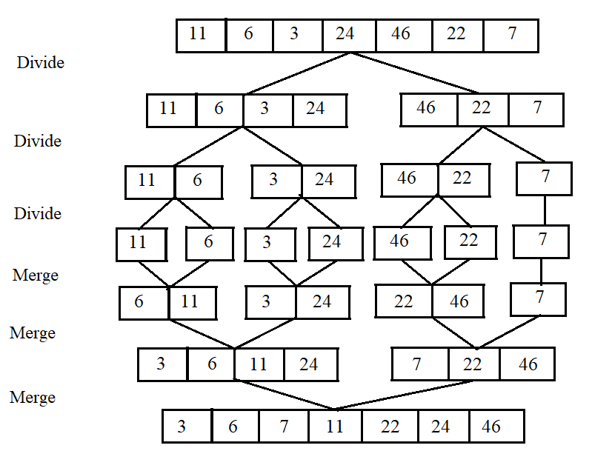
Merge sort Example:

Slide 8
EXAMPLE
1 2 3 4 5 6 7 8
11 | 6 | 3 | 46 | 24 | 22 | 7 | 10
first
mid
last
Initial Call ---- MergeSort(A,first,last)
A is an array
first ----- Starting index of an array
last ----- End index of an array
mid ------ (first + last)/2

Slide 9
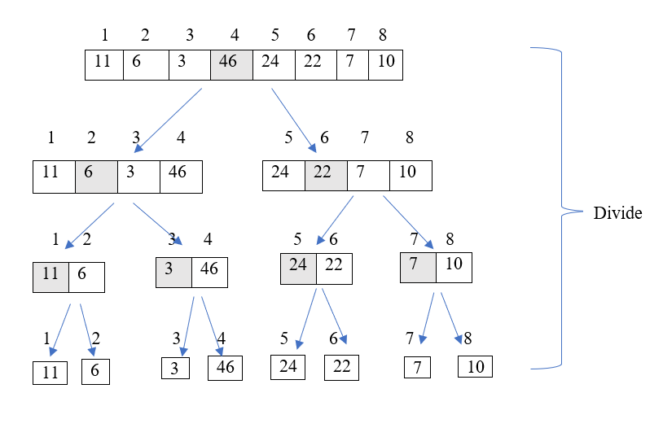
EXAMPLE

Slide 10
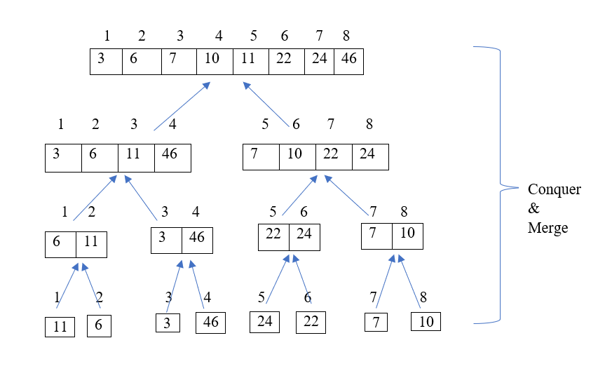
EXAMPLE

Slide 11
Python Code for Merge Sort Ascending order
def merge_sort(arr):
# Base case: If the array has only one element, it's already sorted.
if len(arr) <= 1:
return arr
# Step 1: Divide the array into two halves
mid = len(arr) // 2 # Find the middle index
left_half = arr[:mid] # Left half of the array
right_half = arr[mid:] # Right half of the array
# Step 2: Recursively sort both halves
left_half = merge_sort(left_half)
right_half = merge_sort(right_half)
# Step 3: Merge the sorted halves and return the sorted array
return merge(left_half, right_half)

Slide 12
Python Code for Merge Sort Ascending order
def merge(left, right):
sorted_array = []
i = j = 0
# Merge the two halves into a sorted array
while i < len(left) and j < len(right):
if left[i] < right[j]:
sorted_array.append(left[i])
i += 1
else:
sorted_array.append(right[j])
j += 1
# If there are remaining elements in left half
while i < len(left):
sorted_array.append(left[i])
i += 1

Slide 13
Python Code for Merge Sort Ascending order
# If there are remaining elements in right half
while j < len(right):
sorted_array.append(right[j])
j += 1
return sorted_array
# Example usage:
arr = [12, 11, 13, 5, 6, 7]
print("Original array:", arr)
sorted_array = merge_sort(arr)
print("Sorted array in ascending order:", sorted_array)
OUTPUT:Original array: [12, 11, 13, 5, 6, 7]
Sorted array in ascending order: [5, 6, 7, 11, 12, 13]

Slide 14
Way of Merging Two Sorted Arrays
a1 a1 a2
a1
5 | 6 | 8 | 9
4 | 7 | 10
j
i
Check whether a1[i]<a2[j] or a2[j]<a1[i]
If a1[i]<a2[j] then place the value in array and increment i & k
If a2[j]<a1[i] then place the value in array and increment j & k
k
Now..Now…Lets merge a1 & a2 as a single array ‘A’

Slide 15
Way of Merging Two Sorted Arrays Cont…
5 | 6 | 8 | 9
4 | 7 | 10
a1
a2
j
i
Here a2[j]<a1[i] so put the value of a2[j] to A[k], increment j and k
4
A
k
a1
a2
5 | 6 | 8 | 89
 | 7 | 10
i
j
4
A
k

Slide 16
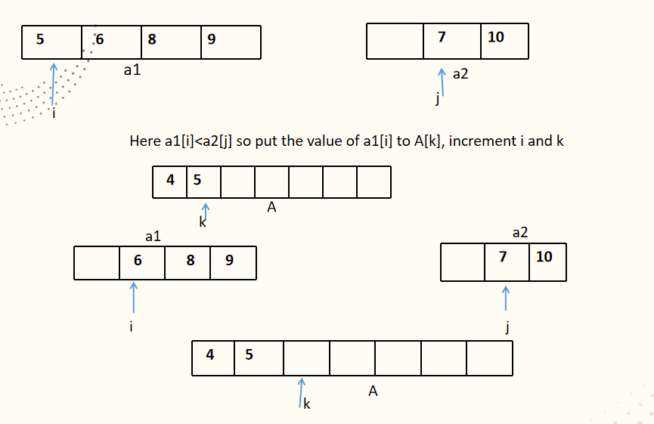
Example Cont….

Slide 17
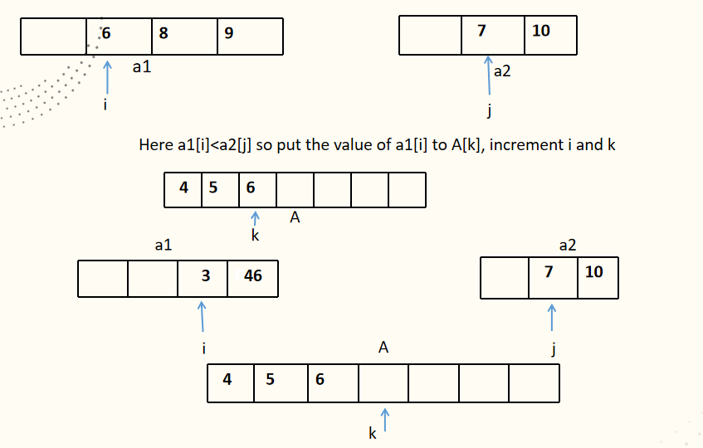
Example Cont….

Slide 18
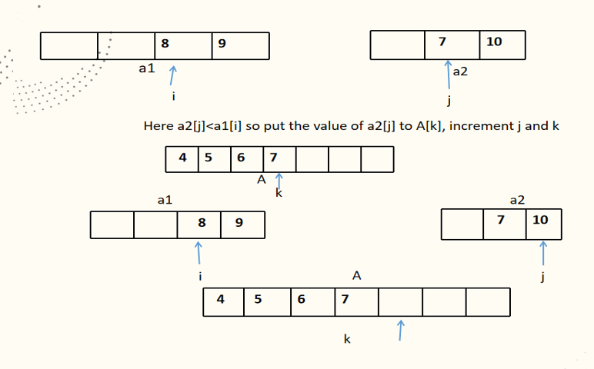
Example Cont….

Slide 19
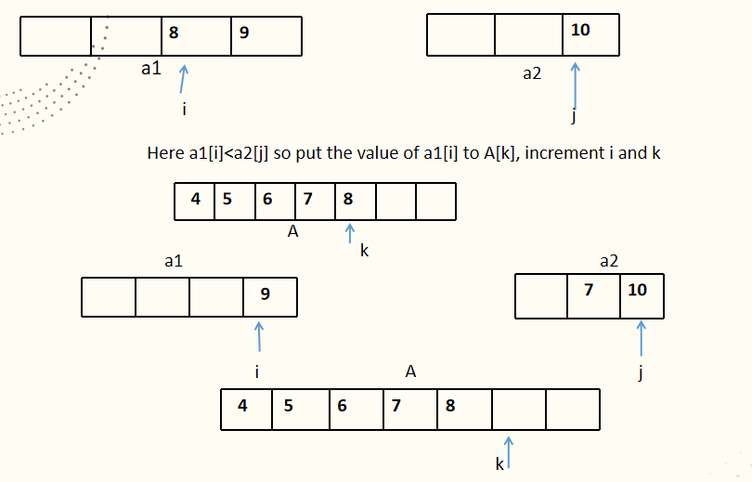
SUMMARY

Slide 20
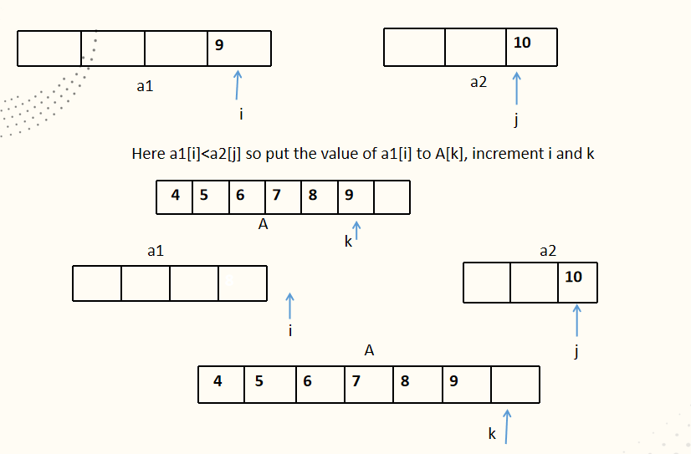
Example Cont….

Slide 21
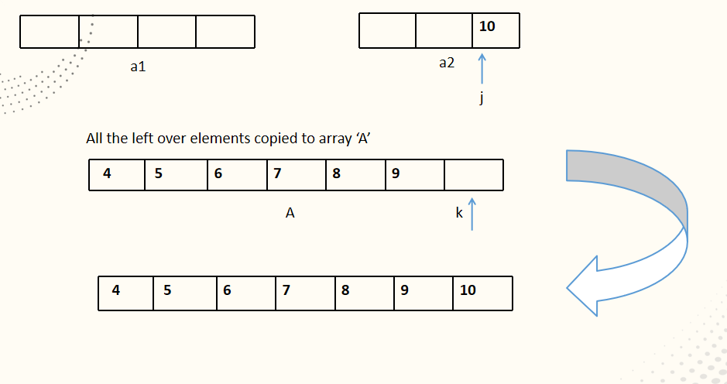
Example Cont….

Slide 22
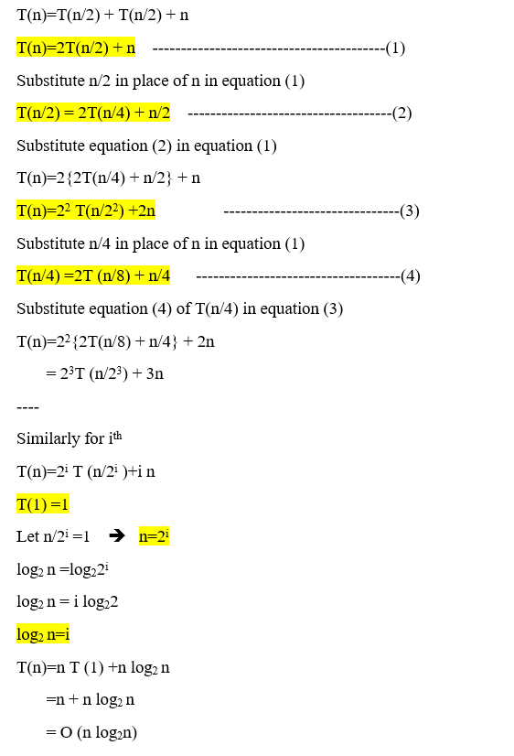
Time Complexity

Slide 23
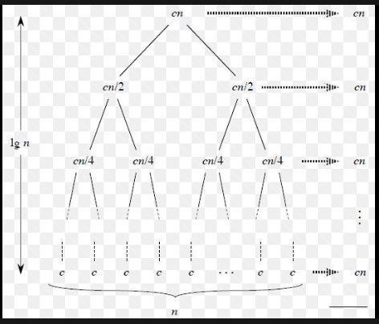
Time Complexity
Time Complexity of merge sort is O(n*Log n) in all the 3 cases (worst, average and best) as merge sort always divides the array in two halves and takes linear time to merge two halves.

Slide 24
Advantage and Disadvantages of merge sort
Advantages | Disadvantages
Time Complexity: O(n log n) | Space Complexity: O(n) (requires extra space)
Stable Sorting: Maintains relative order of equal elements | Not In-Place: Requires additional memory
Consistent Performance: No worst-case O(n²) like Quick Sort | Slower for small datasets: For small arrays, simpler algorithms might be faster
Efficient for Large Data: Works well with large datasets | Complex to Implement: Slightly more complex than simpler sorting algorithms
Works Well with Linked Lists: Efficient for linked lists | Overhead in Recursive Calls: Adds function call overhead due to recursion

Slide 25
Real-Time Applications of Merge Sort:
External Sorting: Handling large datasets that can't fit into memory, like in databases and file systems.
Merging Sorted Files: Combining multiple pre-sorted datasets or files into one sorted dataset, e.g., log file processing.
Sorting Linked Lists: Efficiently sorting data stored in linked lists, suitable for memory-constrained environments.
IoT Data: Sorting large volumes of real-time sensor data in IoT applications.
Analytics and Reporting: Sorting large datasets for analytics or reporting purposes.
Real-Time Merging of Data Streams: Sorting and merging real-time data streams, such as in financial trading systems or live data feeds.

Slide 26
SELF-ASSESSMENT QUESTIONS
What is the best case time complexity of merge sort?
O(n log n)
O(n²)
O(n² log n)
O(n log n²)
2.Merge sort is preferred for arrays over linked lists.
a) true
b) false

Slide 27
TERMINAL QUESTIONS
1. Describe Sorting and what are the key steps involved in implementing Merge Sort?
2. List out the applications of Merge Sort.
3. Analyze Time and Space Complexity of Merge Sort.
4. Summarize the Merge Sort algorithm with an example.

Slide 28
REFERENCES FOR FURTHER LEARNING OF THE SESSION
Textbooks:
Mark Allen Weiss, Data Structures and Algorithm Analysis in C, 2010, Second Edition, Pearson Education.
Allen B. Downey, ”Think Python: How to Think Like a Computer Scientist’’, 2nd edition, Updated for Python 3, Shroff/O’Reilly Publishers, 2016 (http://greenteapress.com/wp/thinkpython/)
Data Structures and algorithms using python, 2011,Rance D, Necaise, himilton printing
ReferenceBooks:
Data Structures and Algorithm Analysis in PYTHON, 2010, Mark Allen Weiss, Second Edition, Pearson Education.
Data Structures and Algorithms, A.V.Aho, J.E.Hopcroft, and J.D.Ullman, Pearson Education, First Edition Reprint2003.
Advanced Guide to Python 3 Programming, John Hunt, 4th Edition, Springer Nature Switzerland AG 2019.
Python Basics: A Practice Introduction to Python 3, David Amos, Dan Bader, Joanna Jablonski, Fletcher Heisler, 4th edition, Real Python.
WebLinks:
https://docs.python.org/3/tutorial/datastructures.html
https://www.w3schools.com/dsa/dsa_intro.php
https://www.geeksforgeeks.org/python-data-structures/

Slide 29
THANK YOU

